Slide 1
OS Introduction
1.1 – OS Basics – cont.
1.2 – Microsoft Windows
1.3 – Unix and Linux for Desktop
1.4 – NOS Basics

Slide 2
Introductory Linux Commands
whoami (who am I)
w (who)
echo $LOGNAME
id –un
uname –a
hostname
“Help” commands:
man <command_name>
whatis <command_name>
apropos <command_name>

Slide 3
Introductory Linux Commands(seminar)
cd (change directory)
mkdir (make directory)
pwd (print working directory)
rmdir (remove directory)
ls (list) -list files & directories from a directory
Special characters:
~ “home directory”
/ “root directory” – the root directory of the Unix/Linux filesystem
An absolute path starts from root: /home/ubuntu/dir1/file01
A path that doesn’t start from root is a relative path:
dir1/dir2/file02

Slide 4
Introductory Linux Commands(seminar)
Creating a shell script:
We are using the pico editor:
$ pico program01 (the $ sign is the Linux prompter)
after we write the code we save the file (Ctrl+o) and exit the editor (Ctrl+x)
We grant execute rights for the program program01 using the command:
$ chmod +x program01
We run the program:
$ ./program01
What represents $PATH?

Slide 5
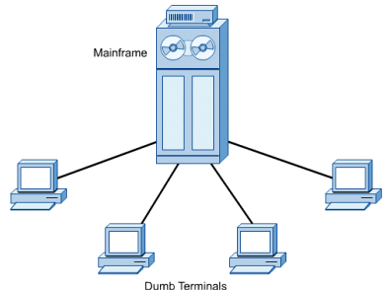
OS for PC-s
Desktop computers become popular in the 80’s.
First users were using the PC-s for diverse functions, like text processing, accounting or gaming.
Their productivity was limited because they couldn’t share information with other systems.

Slide 6
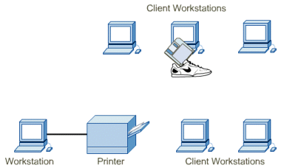
PC-s and networking
As the computer technology have evolved, the companies started to install their own LANs to interconnect the desktop PCs for sharing data and peripherals.
A network operating system (NOS) is using more resources than the desktop version.
A new category of PC-s have appeared: the network servers.
These computers are running a NOS and they became the central point of the network.

Slide 7
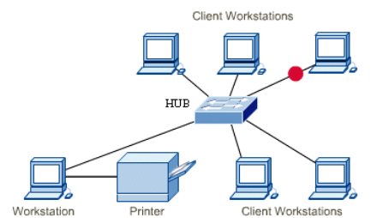
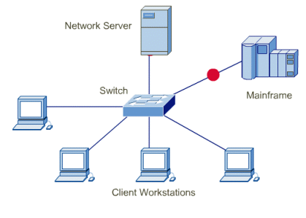
PC-s and networking
Web browsing, e-mail and other web-based applications are used now.
In order to grant access to the Internet technologies, the big software companies (Microsoft and others) re-constructed their desktop OS-s.
Nowadays, desktop OS-s are including many of the services available in the past only for NOSs.

Slide 8
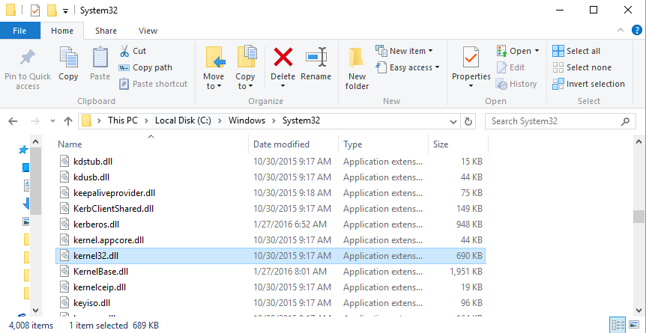
OS Kernel
The OS kernel is the term used for describing the central part of the OS.
This represents a small part of software which is loaded into memory what the computer boots up.
This code contains instructions that enables the kernel to manage hardware devices, memory, system processes and other programs.

Slide 9
OS Kernel
Pentru Linux, the kernel is located in /boot.
For more info, please see:
https://learning.lpi.org/en/learning-materials/010-160/4/4.3/4.3_01/

Slide 10
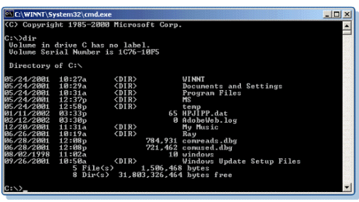
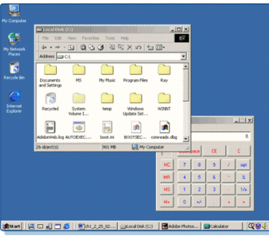
User interface
UI represents the interaction component between OS and user.
UI is like an interpreter that interprets when a keyboard key is pressed, a mouse click or swiping a touchscreen (or another kind of input).
A graphical user interface (GUI) enables the user to use the software using windows, “pull-down” menus, pointers and graphical symbols.

Slide 11
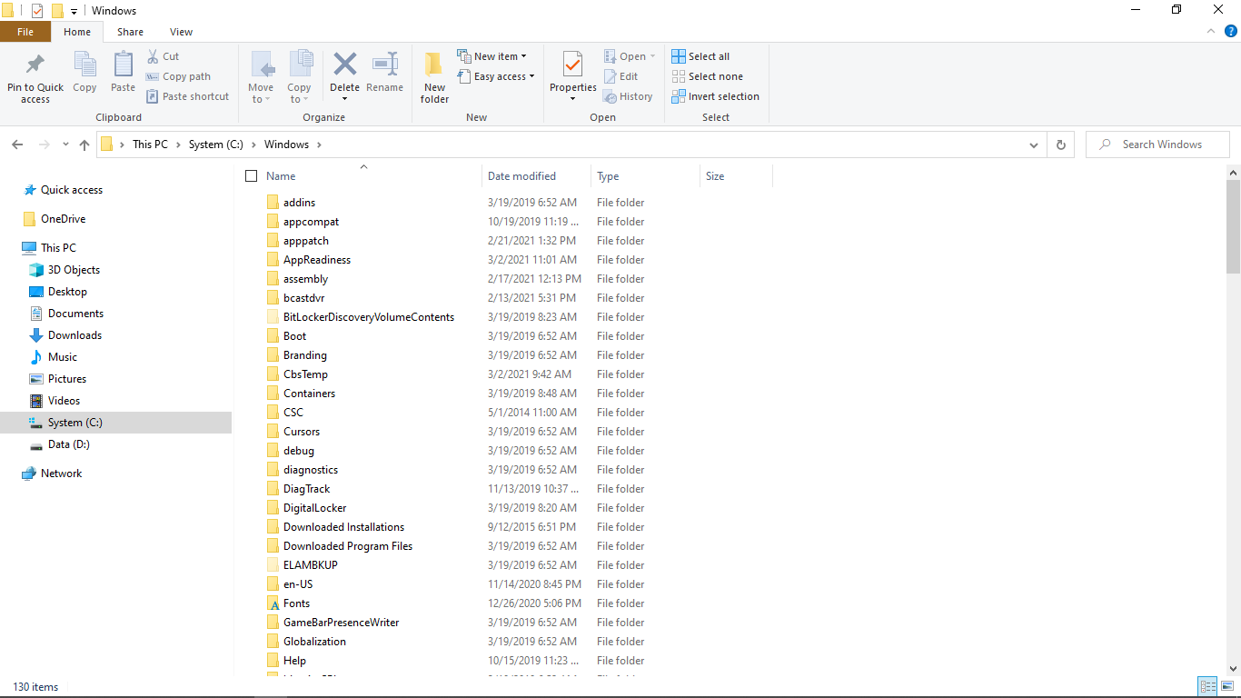
File system
In a hierarchical file system the files are stored into logical containers disposed in a tree order (directories in Unix/Linux and folders in Windows).
The file systems begins the root of the filesystem.
UNIX and Linux are naming these containers “directories” and “subdirectories”.
Windows and Macintosh are using terms of "folder" and "subfolder“.

Slide 12
File systems
File Allocation Table (FAT) – legacy filesystem
Nowadays used for compatibility reasons
Today, FAT file systems are still commonly found on floppy disks, USB sticks, flash and other solid state memory cards and modules, and many portable and embedded devices. DCF (Design rule for Camera File system) implements FAT as the standard file system for digital cameras.
The table contains a map of the files and the place where these are stored on the disk
The FAT table refers to hard-disk clusters (the cluster is the basic unit of information on a HD)
One file can be stored on several clusters, but one cluster may contain only one file.
The OS uses the FAT table to find out all the clusters on disk where the files are stored

Slide 13
FAT fs
3 types of FAT:
The original FAT (FAT12)
FAT16
FAT32
FAT16 and FAT32 are enhanced versions of FAT 12

Slide 14
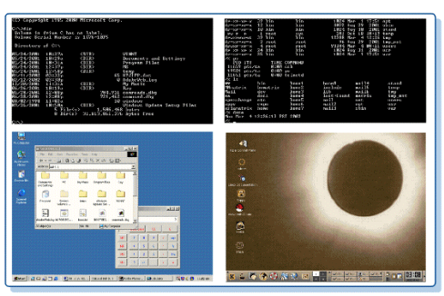
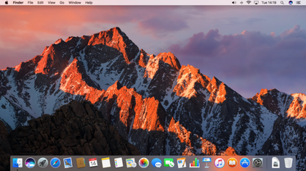
Desktop OSs
Microsoft Disk Operating System (MS-DOS) – one of the first desktop OS-s
Microsoft Windows family includes Windows 95, 98, ME, NT, 2000, XP, Vista, Windows 7, Windows 8, Windows 10.
Apple Macintosh OS (Mac OS) include OS 8, OS 9, and OS X (OS 10), El Capitan, macOS.
Linux – several distributions: Red Hat, Caldera, Santa Cruz Operation (SCO), SuSE, Debian (Ubuntu), etc.
UNIX – versions of the biggest software manufacturers, like HP-UX (HP), Sun Solaris (Sun Microsystems), AIX (IBM).

Slide 15
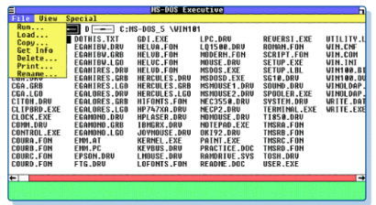
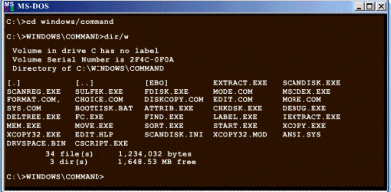
History: MS-DOS
The MS-DOS version was built on the basis of a SO called 86-DOS or QDOS (Quick and Dirty Operating System).
The Seattle Computer Products company have written the QDOS to run on an Intel 8086.
Microsoft have bought the copy-rights for QDOS and released MS-DOS on the market in 1981.

Slide 16
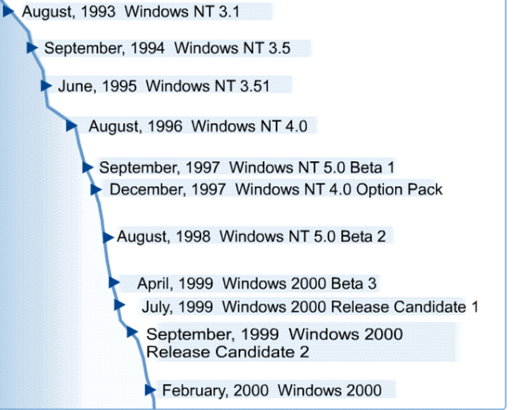
Windows NT and Windows 2000 evolution

Slide 17
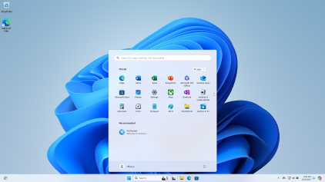
Windows 11
Last version of Windows is 11 - 5 Oct. 2021, with the last update from February 2024 23H2 (10.0.22631.3155).
Microsoft offers major updates once at 6 months.

Slide 18
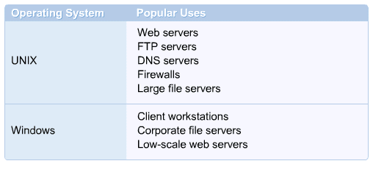
Unix and Linux for Desktop
There are tens of distributions of UNIX and Linux.
A big part of the Internet is running UNIX/Linux.
At the beginning UNIX was seen as not so “user-friendly” but in the last years, Linux changed this image

Slide 19
Linux origins
Beginning with the late ’90s, Linux have became a viable alternative for Windows on desktop.
The popularity of Linux came from using some distributions like FreeBSD and Sun Solaris and today, Ubuntu.
Linux versions can run today on (almost) any processor

Slide 20
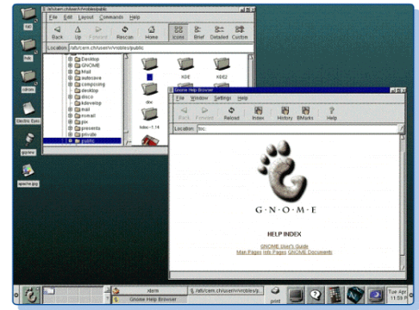
Linux/UNIX GUI
Both UNIX and Linux- are capable of running graphical interfaces (GUI).
For UNIX and Linux we can choose from a variety of graphical interfaces
UNIX/Linux is based on X-Windows system in order to display the graphical interface.
Ex.: GNOME may work with different types of window managers.

Slide 21
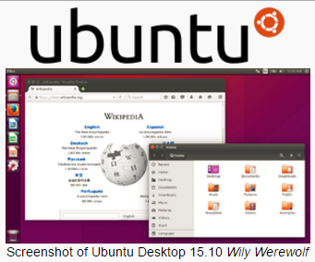
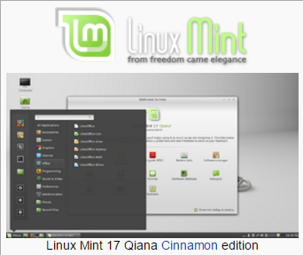
Linux/UNIX GUI
There are many desktop GUIs, like KDE (K Desktop Environment) and GNOME.

Slide 22
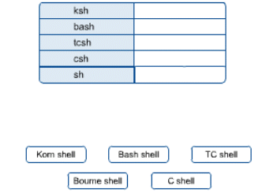
UNIX origins
UNIX and Linux were made to be flexible and customizable.
UNIX and Linux are supporting different user interfaces
The shells are text-based UI. The user is typing a command which is interpreted by the shell.

Slide 23
UNIX history - image
https://upload.wikimedia.org/wikipedia/commons/7/77/Unix_history-simple.svg

Slide 24
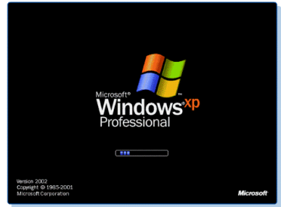
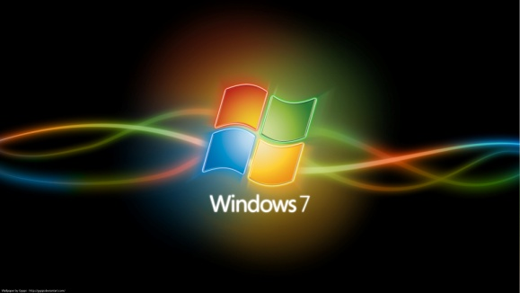
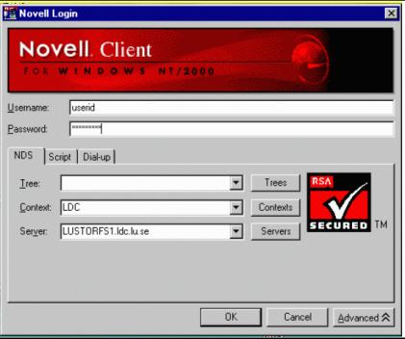
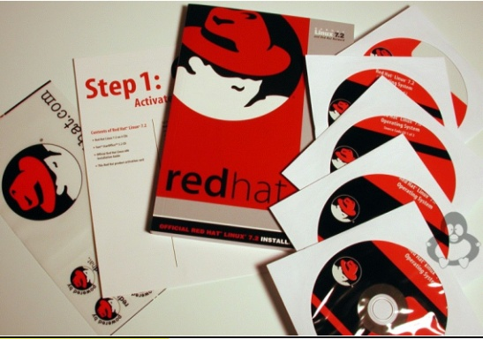
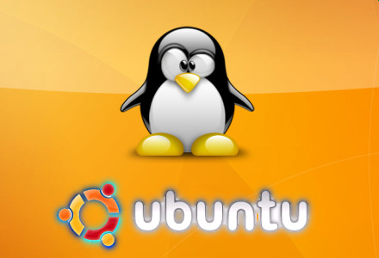
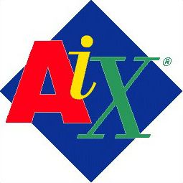
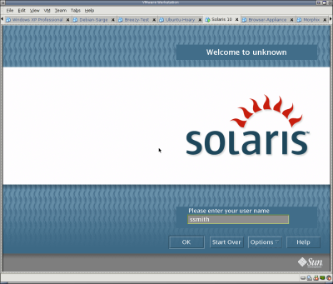
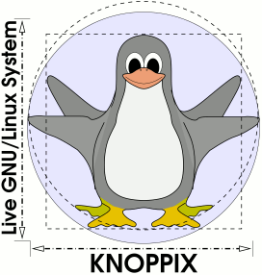
NOS (Network Operating Systems)
A NOS has several integrated services for network connection, multiuser, security and file sharing
Microsoft Windows
Linux
Unix

Slide 25
A short comparison Windows vs. Linux
Windows - “user-friendly” OS, GUI, initially as a desktop OS.
The roots of Linux are beginning with UNIX and modular programming which made Linux popular among system administrators.
Other specific considerations:
Text/graphic interface (both)
Costs (Windows – not free, Linux – free)
Getting/installing the OS
Ability to run directly from a CD (Linux – yes, Windows -no)
Application availability and how to get/buy the software
Vulnerability against viruses (Windows – more exposed)
Security characteristics
Multi-user support (Linux – truly multi-user)

Slide 26
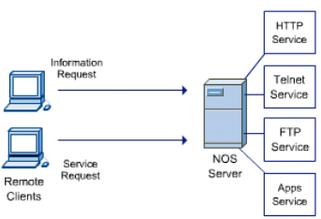
The Client-Server Model
The vast majority of the networking applications are using the client/server model
A server is offering services to a program, which is called a client.
Once is started, the server waits to get requests from client programs. If there is a correct request received, the server responds with a message that contains a proper message to the client.

Slide 27
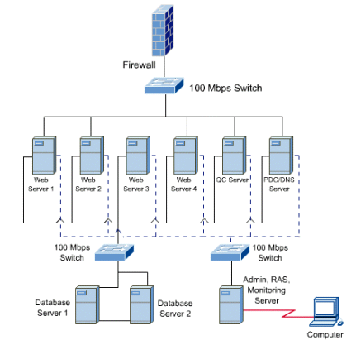
The Client-Server Model
Any computer may act as a server as long is connected to the network and properly configured.
Most of the companies are offering the key services in term of networking by installing high-end computers (servers) to provide agile services to remote clients.

